Slide 1
Python For Data Science 315030
Faculty Name:
Darshan Parmar

Slide 2
About Project
Project title: Stock Prediction
Name: Harsh Gandhi
Enrollment No. : 200050131011
Name: Darji Dhruv
Enrollment No. :200050131009

Slide 3
Description
Stock prediction is the act of trying to determine the future value of a company stock or other financial instrument traded on an exchange.
As we all know the successful prediction of a stock's future price could yield significant profit.
This is python with data science project to predict stock value which will give predict stock go up or own after 15 days from today.

Slide 4
Libraries and dataset
Here in our project we import yfinanace module to get dataset of particular stock.
yfinanace: The yfinance is one of the famous modules in Python, which is used to collect online data, and with it, we can collect the financial data of Yahoo.
With the help of the yfinance module, we retrieve and collect the company's financial information (such as financial ratios, etc.)

Slide 5
Libraries:
Numpy
Pandas
Matplotlib
pandas_datareader
Scikit-learn
keras

Slide 6
Cleaning and scrubbing method on data
Data cleaning: Data cleaning is the process of fixing or removing incorrect, corrupted, incorrectly formatted, duplicate, or incomplete data within a dataset. When combining multiple data sources, there are many opportunities for data to be duplicated or mislabeled.
Data Scrubbing: Data scrubbing refers to the procedure of modifying or removing incomplete, incorrect, inaccurately formatted, or repeated data in a database. The key objective of data scrubbing is to make the data more accurate and consistent. Data scrubbing is a vital strategy for ensuring that databases remain accurate.

Slide 7
Model Use to prediction
LSTM Model: An LSTM module has a cell state and three gates which provides them with the power to selectively learn, unlearn or retain information from each of the units.
The cell state in LSTM helps the information to flow through the units without being altered by allowing only a few linear interactions.

Slide 8
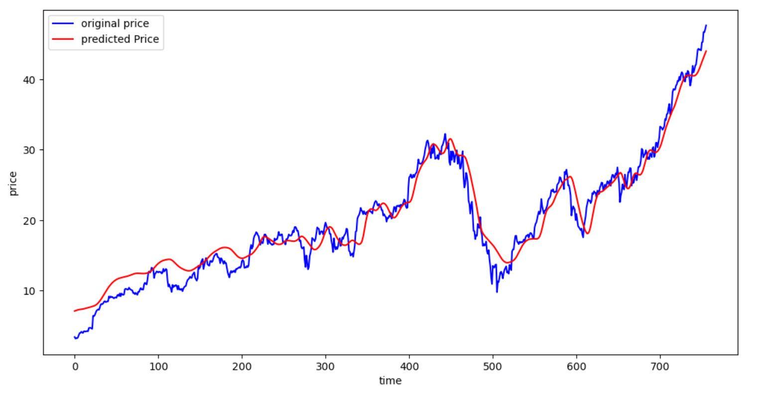
Desired Out-Put

Slide 9
Thank You

